Slide 1

Recovering From a Crashed Day End
Gem Stone-Logan
The Seattle Public Library

Slide 2
Day End
A nightly program that runs essential Horizon processes.
Day End processes can be run:
Automatically
Manually
Individually

Slide 3
Steps to Recover from a Crashed Day End
Is there a problem?
Did Day End never start or did it crash in the middle?
If it crashed in the middle, we need to:
  Learn what processes still need to run and in what order.
  Learn what arguments are needed for these processes.
  Learn what date Day End needs to run for.
  Run the individual processes.

Slide 4
Is There A Problem?
Open up Table Editor
Open up de_activity
Search by date or date range
Check and see if Day End finished all it’s processes.

Slide 5
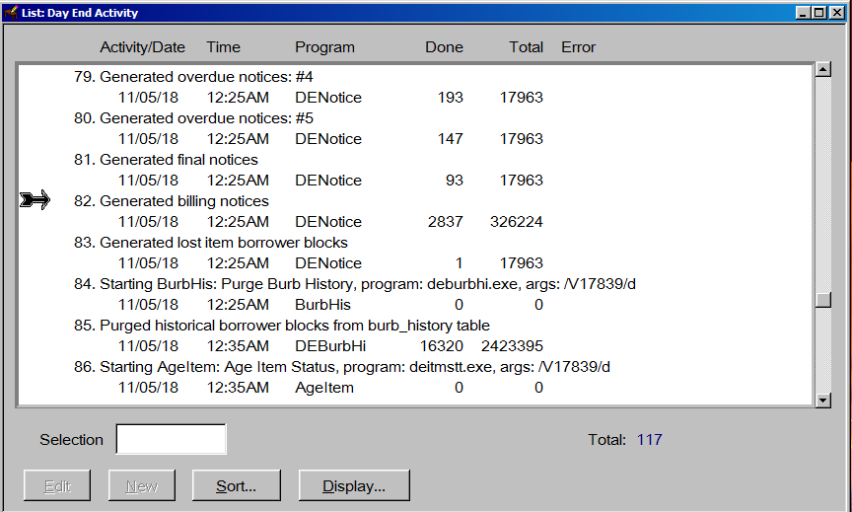
Is There A Problem?

Slide 6
Day End Email
Send a Day End Completed email to staff:
https://support.sirsidynix.com/kb/164207
COSUGI 2017 Lightning Talk – “Monitoring Horizon Processes and Online Catalogs” by Michael Engelbrecht

Slide 7
If Day End Never Ran
Run Day End manually for the prior day:
Open up Day End Processes within Horizon.
Click the checkbox to Run for Previous Day.
Click the Manual button.
Verify it’s the correct date and then click OK.
IMPORTANT: After Day End is finished, remember to change it back to Automatic.

Slide 8
Finding Which Processes Should Run
Open up Horizon and open the Table Editor.
Search for menu and click OK.
Hit Alt+F2 to pop up the compound search option.
Search for the menu MDayEnd.

Slide 9
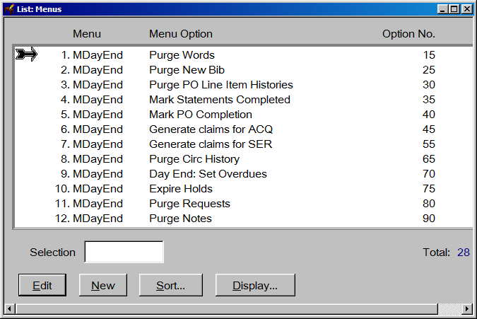
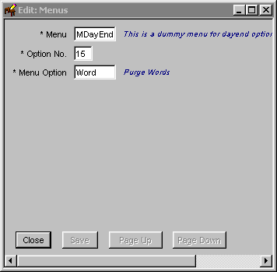
Finding Which Processes Should Run

Slide 10
Viewing Menu Option Details
Finding Which Process Should Run
Open up Horizon and open the Table Editor.
Search for menu_option and click OK.
Hit Alt+F2 to pop up the compound search option
Enter the menu_option you wish more information about and click Search.
Highlight the menu_option and click Edit to see details.

Slide 11
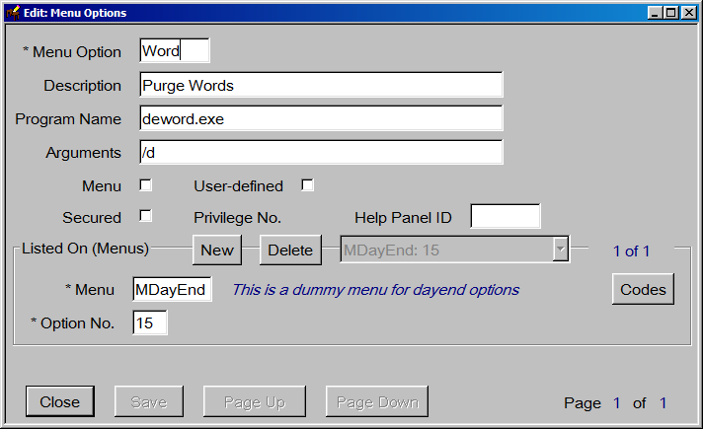
Viewing Menu Option Details

Slide 12
Viewing Processes with SQL
SELECT m.ord, m.menu_option, mo.program_name, mo.descr, mo.arguments
FROM menu_option mo
JOIN menu m ON m.menu_option=mo.menu_option
WHERE m.menu='MDayEnd'
ORDER BY m.ord

Slide 13
Viewing Processes with SQL
DeTcNtc | DETcNoti.exe | Generate Telephone Messaging notices | /d
DeTcWrt | DETcWrit.exe | Write Telephone Messaging Call File | /d
DeDebtU | rundc.bat | Day End Debt Collection - Update | /d /g1 u e d
DeDebtN | rundc.bat | Day End Debt Collection - New | /w2 /g1 n e d

Slide 14
Decoding the Arguments
/d | Daily
/w2 | Weekly, on Tuesday
/m15 | Monthly, on the 15th
/a | Annually
/g1 u e d | Debt Collect, update of group 1 borrowers
/g1 n e d | Debt Collect, new borrower submission of group 1

Slide 15
Figuring Out the Date
Horizon stores dates as the number of days since January 1, 1970.
Ways to Calculate:
select datediff(dd,'1 jan 1970',getdate()-1)
https://www.wolframalpha.com/input/?i=January+1st,+1970 (subtract a day)
IMPORTANT: Bad things will happen if you use the wrong date.

Slide 16
Running Individual Processes
Open the Horizon client
Open a command line and browse to the Horizon directory
Example command:
Deword.exe | /V17934 | /d
[Process] | /V[Date] | [Arguments]

Slide 17
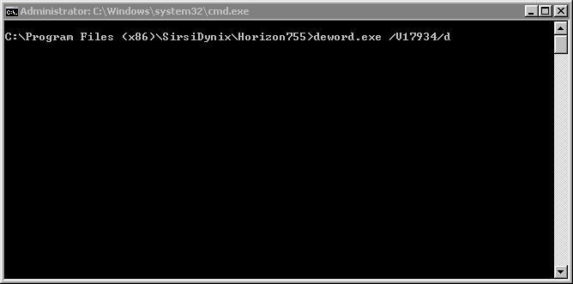
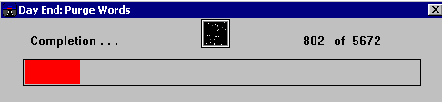
Running Individual Processes

